Slide 1
Cyber Network Capture Generator
Jacob Perin, Luke Tang, Collin McElvain, Abdelrahman Baz, Hazem Abdeltawab, Bernard Ang

Slide 2
Functional Requirements
Ubiquitous Requirements:
The hypervisor software shall be remotely accessible through a web application
The web application shall allow the user to create network capture from pre-determined combination of client, server, daemon(s), application, and activity
The generated network flow shall be stored in a database for later access
Event-driven Requirements:
When the user selects client/server combination the hypervisor shall allocate and create two separate virtual machines
When the hypervisor has created a virtual machine the configuration management shall establish a connection and load configuration file to virtual machine
When configuration management has initialized a virtual machine the application shall load/execute behavioral scripts on the virtual machine
Notes:
Luka Tanga

Slide 3
Non-functional Requirements
Performance
Demonstration of a working system.
Scalability
Prototype will handle at least 2 virtual machines on a network.
Store scenario data for at least one hour long session worth of traffic flow of the virtualization network.
Availability
Available only to our team of developers and permissioned users during our prototype development.

Slide 4
Non-functional Requirements (Cont.)
Reliability
Always properly store compressed PCAP in a reliable manner.
Spun up virtual machine scenarios should have a 99% success rate.
Recoverability
No backup data will be required for the prototype development.
Maintainability
Be able to continue development of features and bug fixes of the project beyond the 492 Spring semester at Iowa State University.
Notes:
Luka Tanga

Slide 5
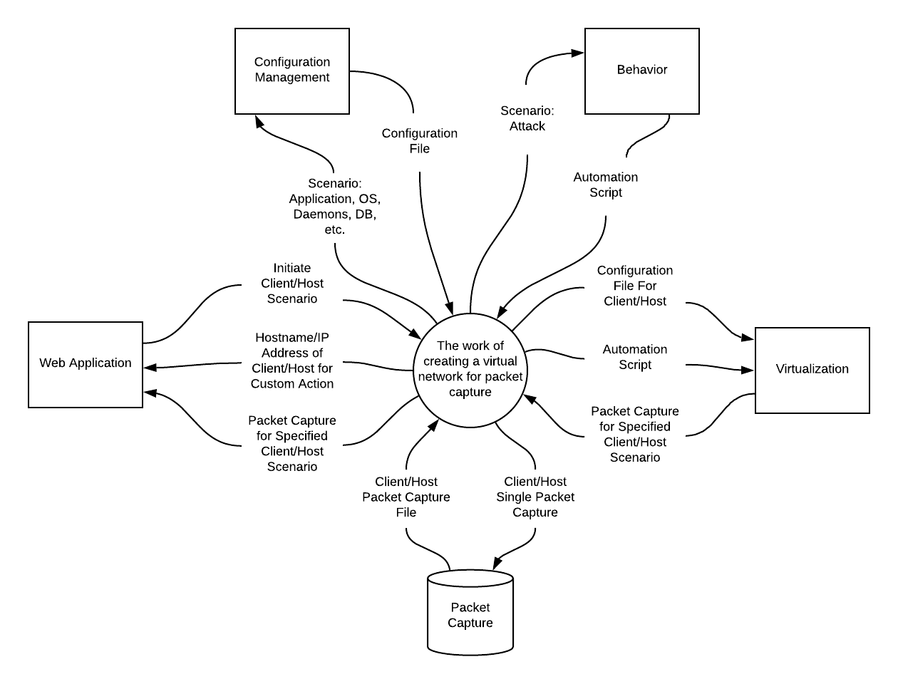
Design Plan
Web application that can automate client / server creation, behavior, and collect the resulting network traffic between machines.
Notes:
Luka Tanga

Slide 6
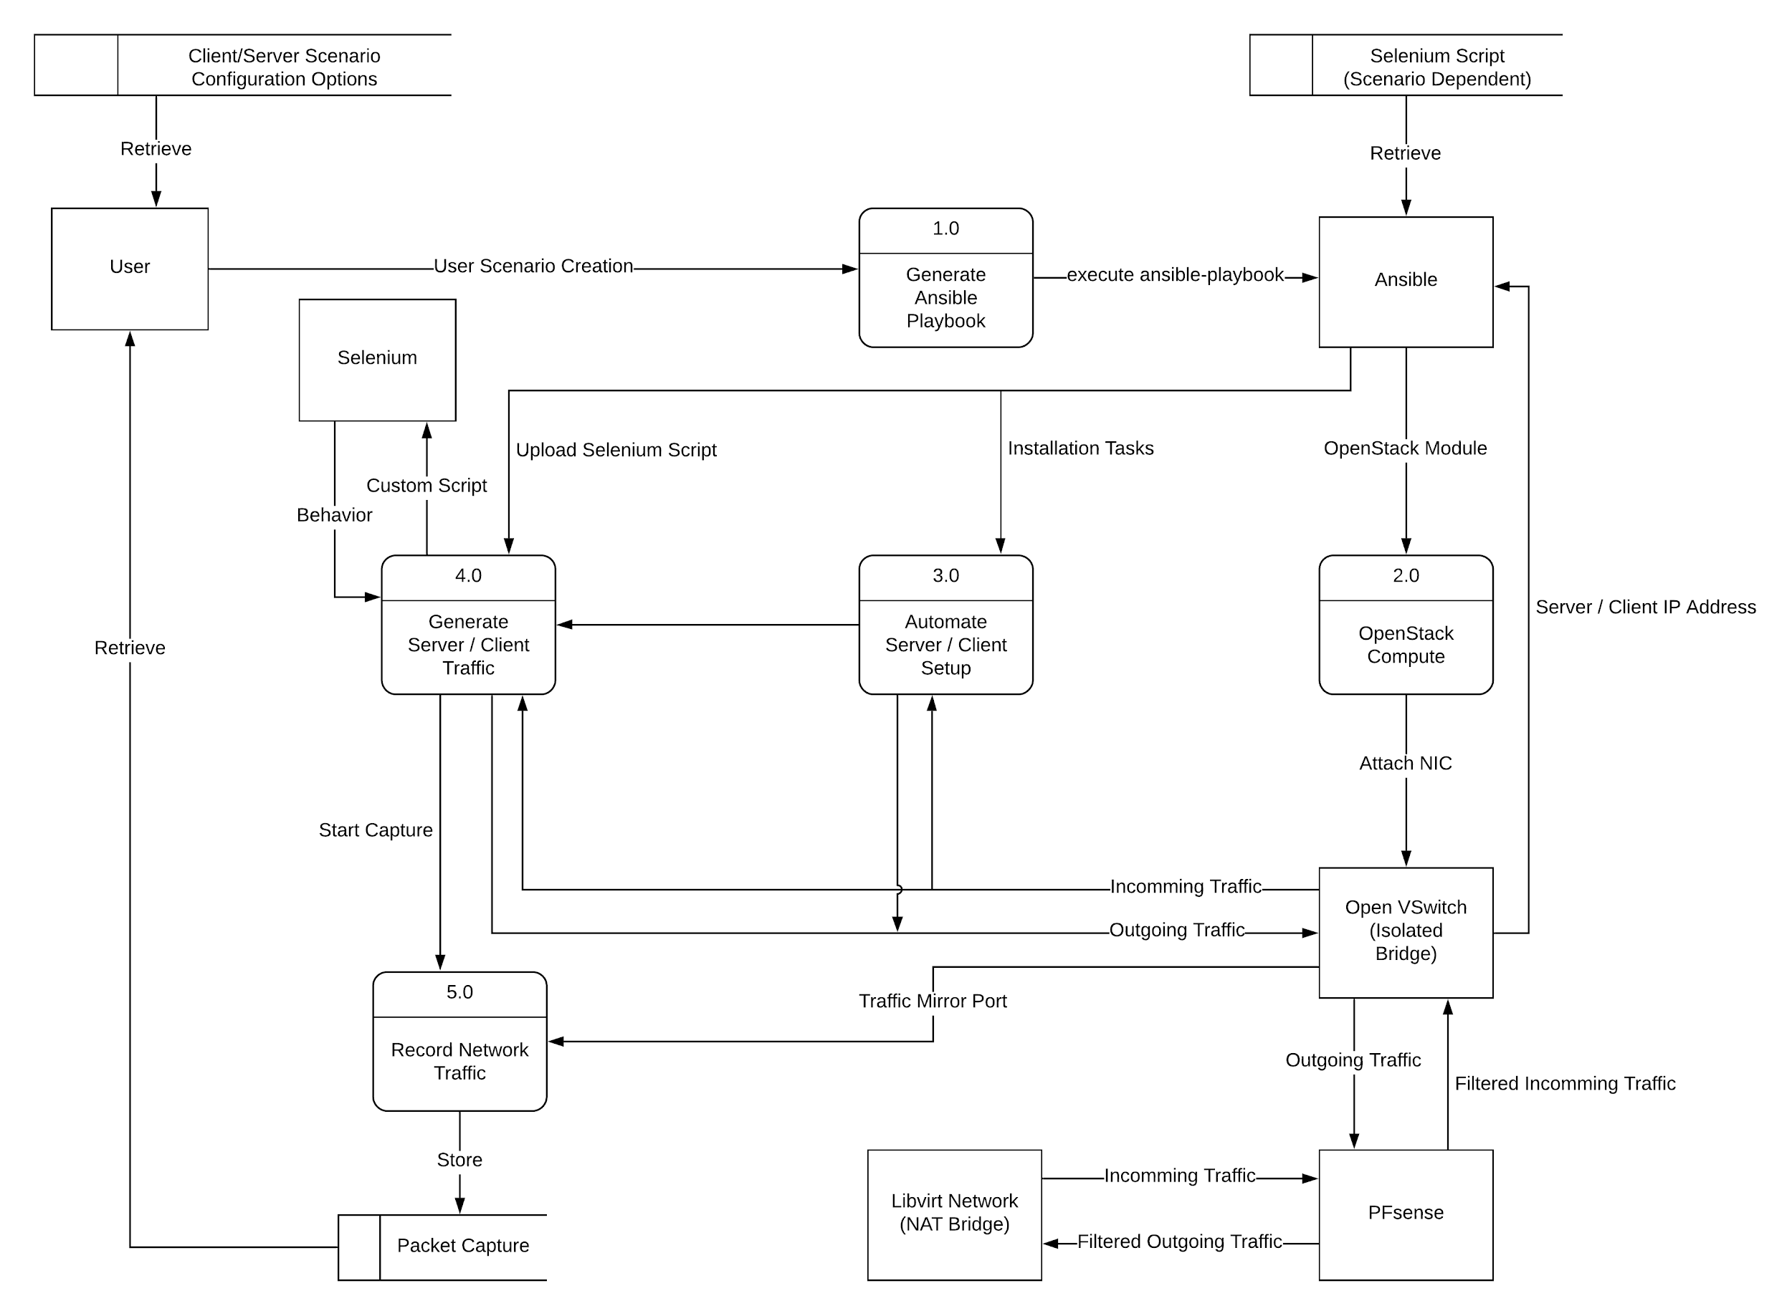
Design plan
Steps:
Generate configuration file with specified criteria
Generate traffic pertaining to scenario on both client and server
Record traffic
Notes:
Jake Perrino

Slide 7
Design Objectives, System Constraints, Design Trade-Offs
Design Objectives:
In a safe manner, simulate scenarios between a client and server in a virtual envioronment.
Simple management, repeatability, and collection of scenarios from a remotely accessible application.
System Constraints:
Open source software (free)
Single machine
Design Trade-Offs:
Simplicity
Open source projects add complexity
VMware / Ansible Tower / AWS may offer more elegant solutions

Slide 8
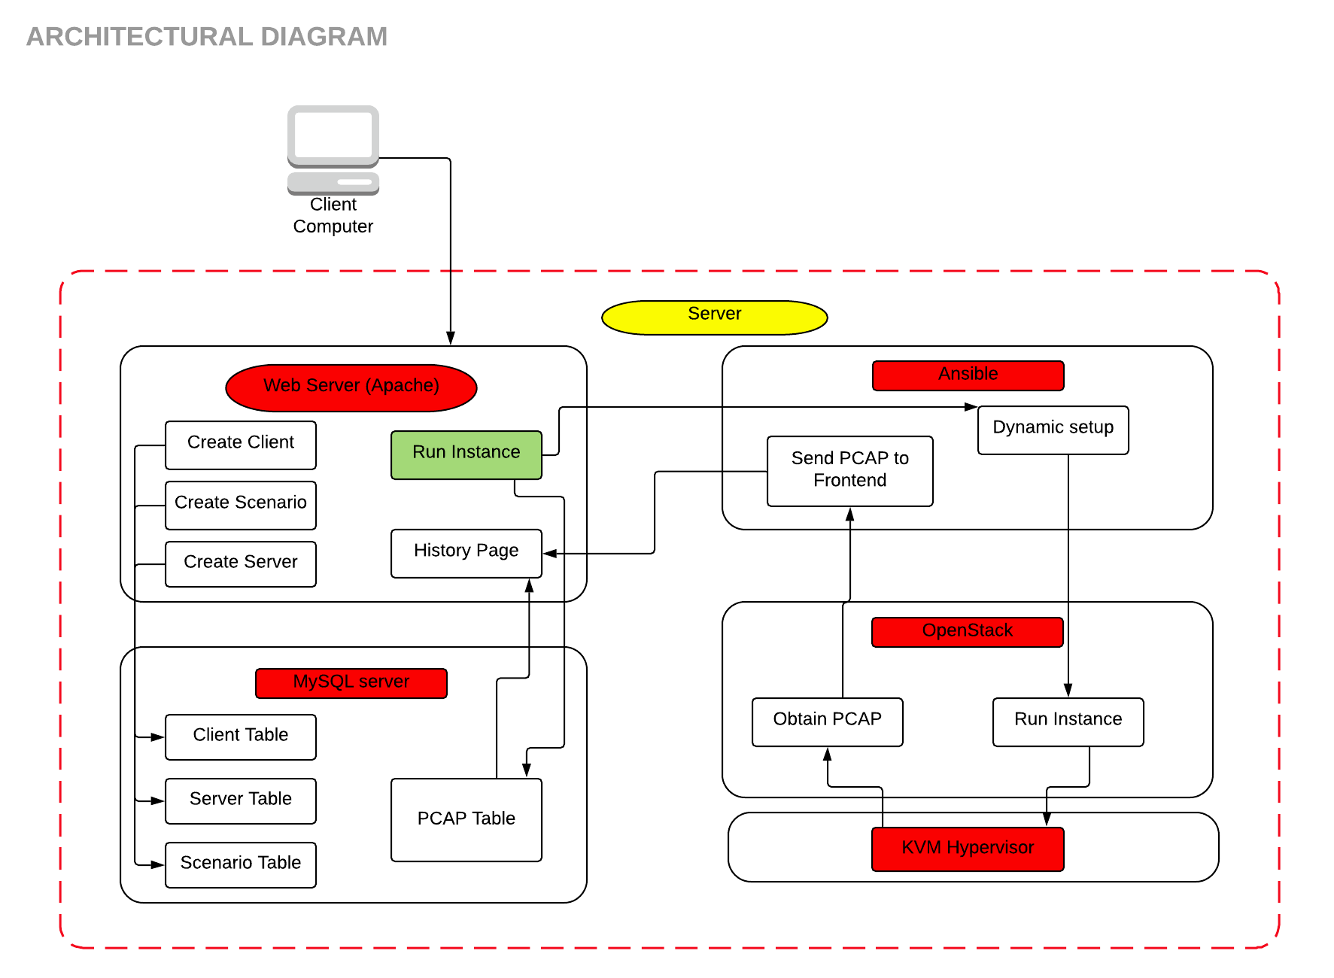
Architecture Diagram

Slide 9
Interface
Web application UI.
This is the interactivity between the user client and the rest of the system through the centralized web application.
This interface will require ease of access in a user friendly fashion.
This interface should only be used by authorized and authenticated users
User will be able to provide input for client, server, daemon, application, and activity based on predetermined lists.

Slide 11
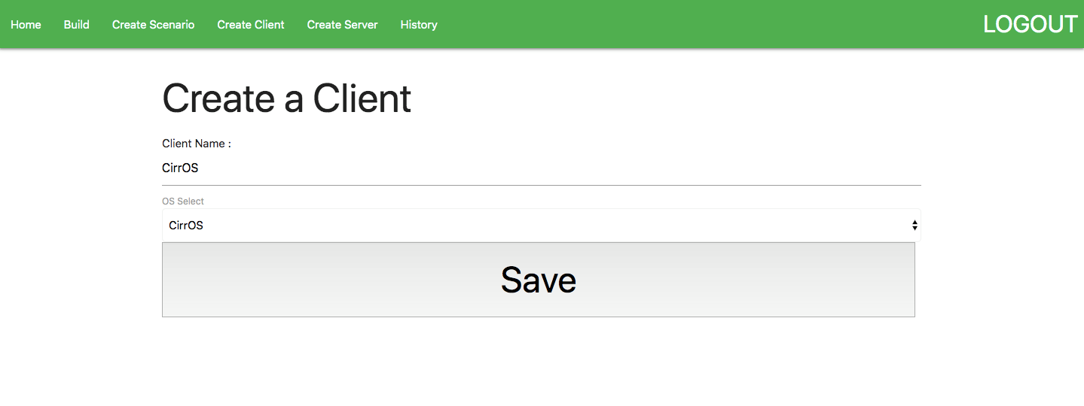

Slide 12
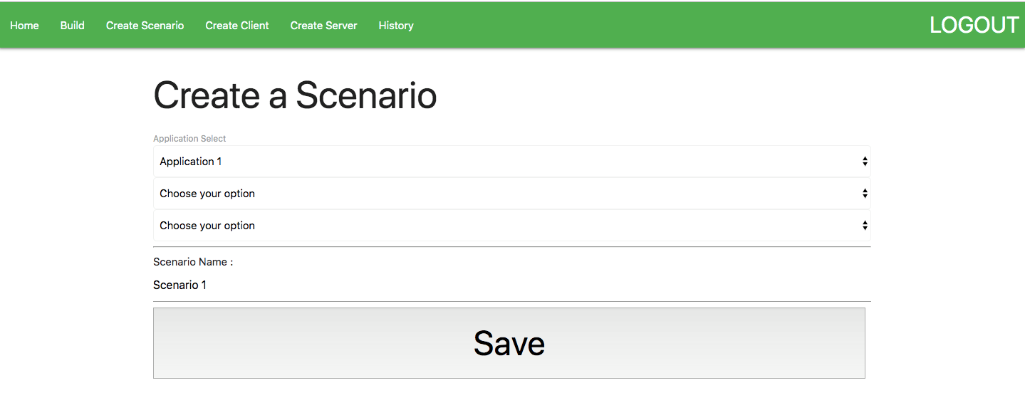

Slide 13
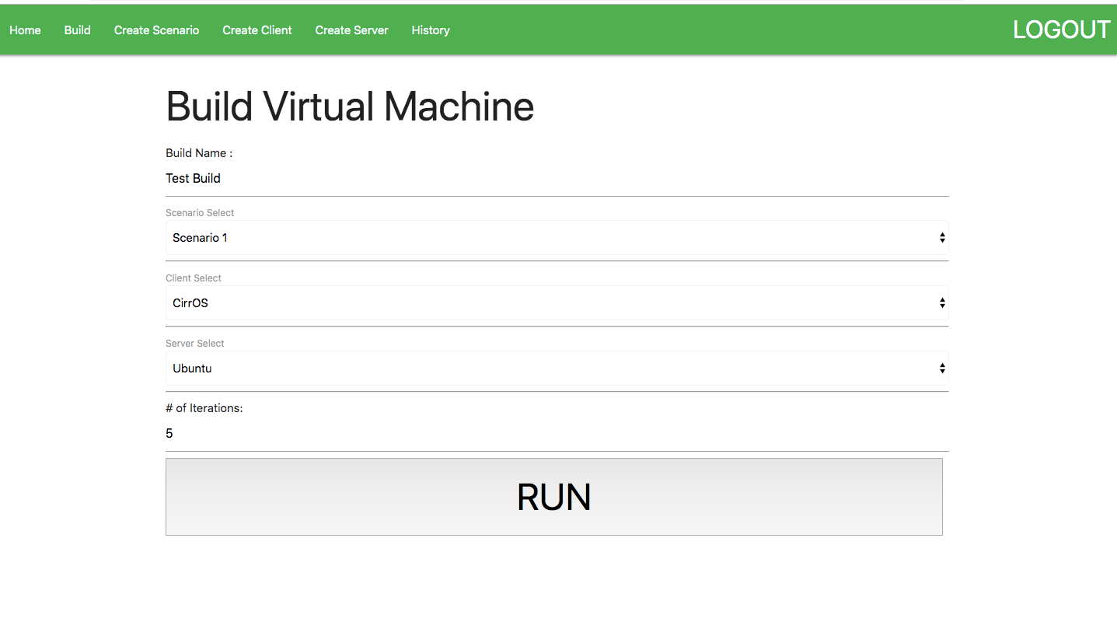

Slide 15
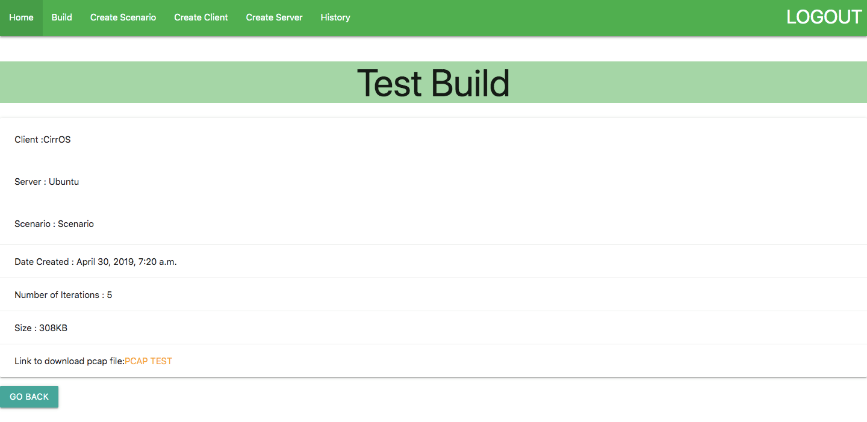

Slide 16
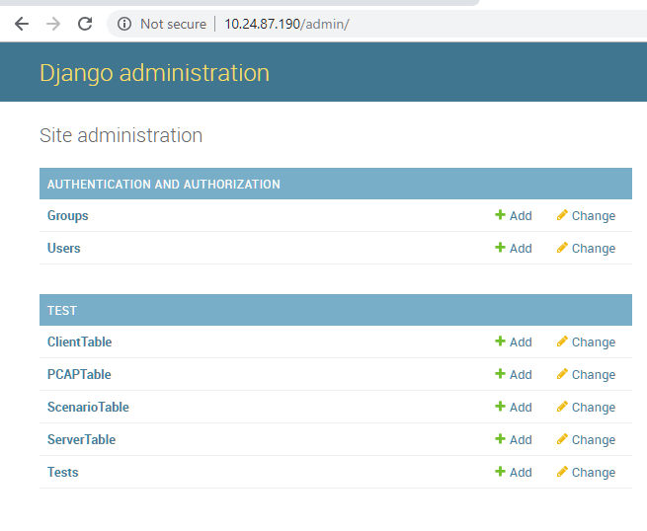

Slide 17
Description of Constraints and Interfaces
Constraints
Open-source
Single machine
Interfaces
Web App
Database
Ansible
Openstack

Slide 18
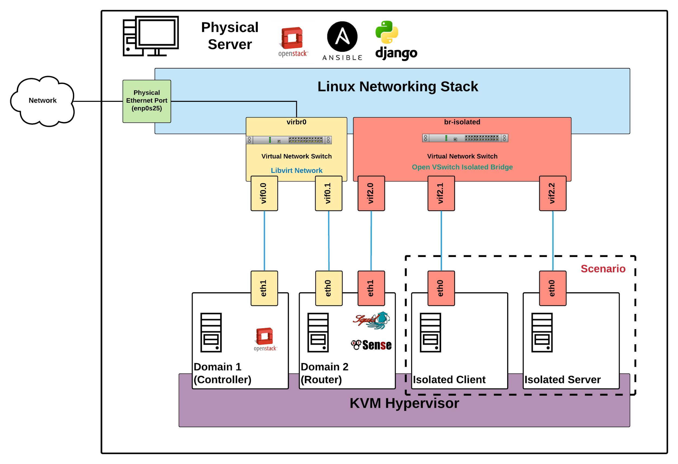
Implementation
Location of applications as installed on physical server
Network diagram of bridge configuration and logical flow between interfaces.
Notes:
Jake Perrino

Slide 19
Rational (Backend)
OpenStack
Long and difficult setup, however, straight forward
High support
maximize options to try for networking and configuration management
Ansible
Straight forward playbooks for implementation
Modules for support with many projects (OpenStack, Open VSwitch, etc.)
Open VSwitch
Compatible driver in OpenStack
Very advanced - only breached surface in project - support for many future features
Django
Python backend for easier management and tie in to server logic
Notes:
Jake Perrino

Slide 20
Applicable Standards and Best Practices
PEP8
CAPEC
IEEE
Standard for Local and metropolitan area networks - Bridges and Bridged Networks
Notes:
PEP8
Code styling standard for all python code
CAPEC
active catalog of attack vectors
Tasks executed in our application for any given attack scenario should correlate directly to the matching vector described in the cataloged attack scenario
Malicious applications should be limited to the intended virtual environment
IEEE Standard for Local and metropolitan area networks - Bridges and Bridged Networks
Background: Network developed must contain malicious traffic to specific host and client. Accomplished by bridging the traffic generated by each host through a proxy.
Section 7 as outlined in this document describes best practices when bridging a network of VLANs. Incorporating this standard will prevent network leaks that could result in consequences for victim users outside network.

Slide 21
Testing and Evaluation
- Test plan - testing method (manual, automated, combination), test case selection and test coverage
- Unit testing
- Interface testing
- System integration testing
- User-level testing (if applicable)
- Evaluation (if applicable) - Performance metrics, Test cases, evaluation results

Slide 22
Manual Testing
Database Testing
Server Data
Modify Client Information: OS ( Ubuntu, Linux, Kali, CirrOS, etc.)
Modify Server Information, such as Apache.
Modify Scenario specification: ( Behavioral Testing)
Frontend
Testing for crashes by storing a large amount of data inside Database
Allow information in database to be successfully received by website
Download PCAP file with all information from the Virtual Machine

Slide 23
Interface Testing
Frontend
User selects scenario, server, client and number of iterations and builds the VM.
User selects applications and updates the MySQL scenario database.
User selects operating system for server and client and updates the MySQL database.
Backend
PCAP capture on HTTP client/server requests between the two virtual machines.
PCAP capture on nmap port scan from one virtual machine to another.
PCAP capture on SSH requests between two virtual machines.
PCAP capture on Selenium web crawler impersonating human traffic.

Slide 24
System Integration testing
OpenStack and Ansible communicate and can instantiate virtual machine through module
Open VSwitch and OpenStack allow peer-to-peer traffic communication
Open VSwitch forwards traffic through PFsense
Libvirt forwards traffic through PFsense

